Slide 1
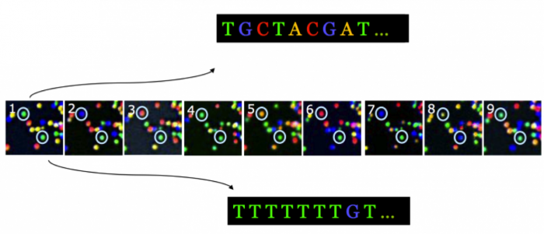
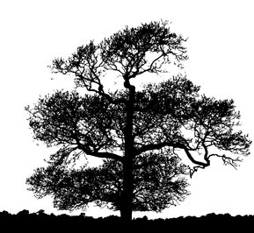
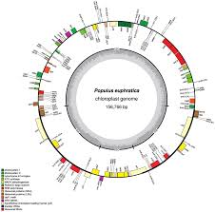
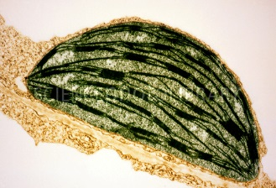
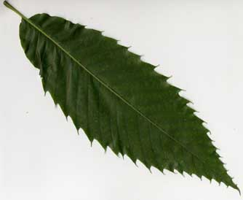
B3- Olympic High School Bioinformatics
Dr. Jennifer Weller
May 2016
Sample Prep for Sequencing and Bar Codes
Notes:
How do you go from the organism (the American Chestnut tree) to a sample you can collect (the leaf), to the part of the leaf of interest (the chloroplast) to the chloroplast DNA (from sequencing) to putting the sequence together in order (a map) and labeling the parts (annotation) so you can pick out one particular region that you want to barcode?
Part of this involves the wet-lab process that we do in the Summer Science camp, where we use wet-lab tools to purify the DNA sample and carry out the sequencing.
Part of it is a computational process – it still requires tools and knowing how to use them. One of the things you can do is complete the circle to go back to the lab with better (more focused) assays.

Slide 2
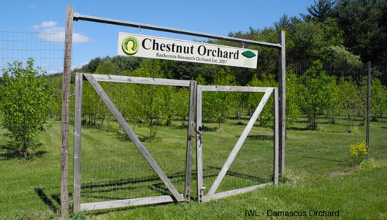
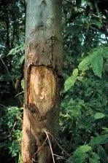
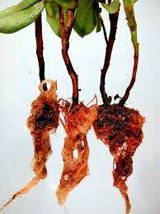
Organism Selection
Where is the organism or collection of organisms
  Do you have permission for your study?
What trait or traits (structure and function) is to be observed and measured?
  Morphological (measurements of the body of the organism)
  Behavioral
  Molecular
Sample part – what part has the variation you are interested in?
Notes:
History – where did things come from , what has shaped their current lifestyle, what forces acting now are shaping what they will become?

Slide 3
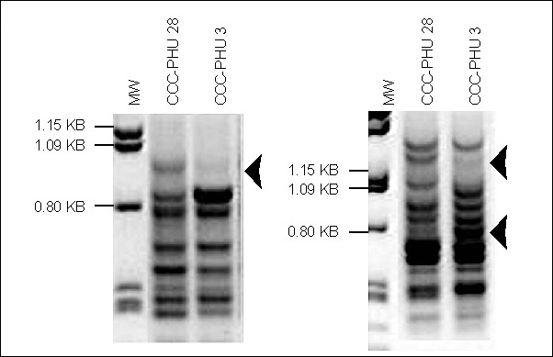
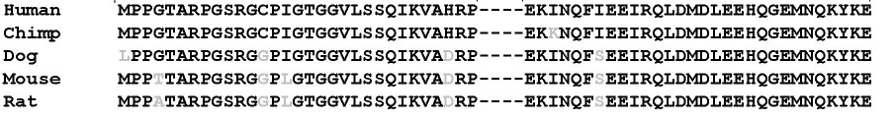
Trait selection
Gene→ mRNA → Protein → Function → Phenotype
Phenotype is the collection of physical traits that result from genotype
  How much of a trait depends only on the genes?
  How much do differences in genes drive differences in traits?
  How different are organisms in the same species from each other?
  How different are organisms in different genus from each other?
Genes are heritable expressions of cellular potential and affect how an organism looks or responds to its environment.
Notes:
A trait is something you can observe and measure. The type of trait you pick depends on the type of question you are asking.
If you want to be able to identify an individual at any point in its lifetime, what do you want? (always present in every cell, known to vary enough to give a unique signature in every individual, which indicates nuclear DNA, or a combination of nuclear and organelllar DNA).
What other things affect an organism? - the environment before and after conception. Some previous exposure of the parents.
Differences in the same gene are called alleles – this can cause differences in how much of a gene is made, or how the signals to turn the gene on and off are interpreted, or in the gene product, such as a protein, that might be defective, not carrying out its function very well.
Population studies look at not just differences in individual genes, but in sets of genes that might travel together, and give a subpopulation an edge in a particular environment.
At the genus level – how do we characterize this? Morphologically, would someone from Mars know that Chihuahua’s and Great Danes are the same species. Would they think they were the same genus? Consider the hyena, which is closer to the cats than the dogs.
Lab: morphological. Gene sequences for 1 conserved, 1 divergent and 1 discriminatory sequence.

Slide 4
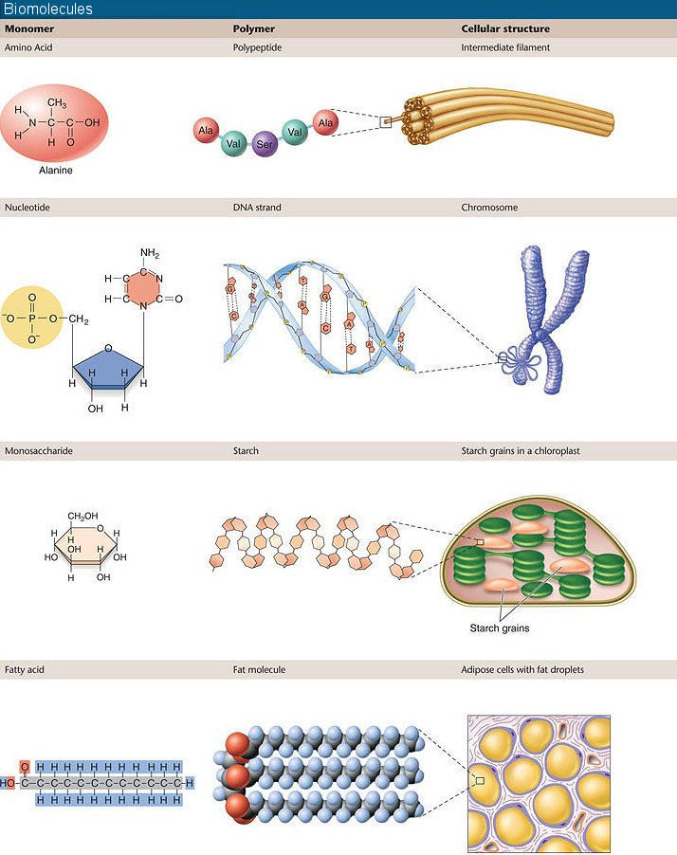
Molecules produced by cells can either be persistent, turn over or be excreted
Different classes of molecules have different chemistries
  This affects the assays you carry out
We can detect tens of thousands of molecules for most classes of biological molecules
  Smaller amounts of biological material have to be collected, stored and processed.
Notes:
Lab – for internet searching
How many leaf cells do I have to collect in order to have 100,000 chromosomes? Note that plants may be diploid, tetraploid, hexaploid, octapolid, decaploid etc. – assume a diploid. Chloroplasts? How much does such leaf tissue weigh?
How many leaf cells do I have to collect in order to have 10ng of RuBisCO protein?
If I am studying flower morphology, how many flowers can I sample in one day if it takes me 10 minutes to observe and score each flower (assume you are really dedicated and can stare through a microscope for 8 hours without going crazy)?
If you collect blood to carry out a DNA identity test, what cells are you targeting?

Slide 5
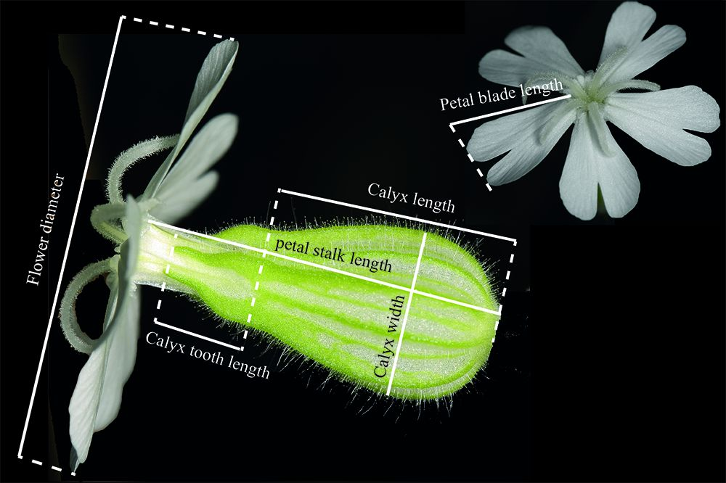
Choose Your Biomolecule
  A piece of DNA on a chromosome in the nucleus or an organelle
    May be part of or closely linked to a gene that makes a protein that affects cell survival
    May be part of controlling elements
    May be in the larger area of ‘non-coding’ DNA
  A mRNA, or set of mRNA molecules
    The sequence will reflect the underlying gene sequence variation
    From housekeeping genes
    From particular types of cells
  A protein produced in particular cells under known conditions
    The protein sequence may or may not reflect the underlying DNA variation
    May have different activities, including interactions between proteins
    Made in large amounts, easy to purify, easy to tell apart from other proteins
  Small molecules like sugars
    The profile reflects the current nutritional and activity status, perhaps exposure to environmental conditions
Notes:
Lab – for internet searching
How many copies of a chromosomal gene sequence are present in human skin cells? Red blood cells? Reproductive cells? Heart muscle cells?
How many copies of a mitochondrial gene sequence are present in human skin cells? Hair follicles?
If you collect blood to carry out a DNA identity test, what cells are you targeting?

Slide 6
Additional considerations when planning your study
Regulatory and management issues
  IRB, IACUC approval?
  Biosafety Committee approval (e.g. recombinant material)?
  Restricted access?
  Disposal limits?
  Space and time needed to carry out the work if bio-controls are required?
  Specialized Training?
Availability of Genomic and Genetic resources
  Is there a genomic reference sequence?
  How available are ‘tools’ = methods and reagents?
Notes:
If you want to work on the tomato genome, is there a completed genome? What other genetic tools are available? How do you find out?
Where do you find out about the other regulatory requirements, rules and regulations? Are all institutions, states, federal agencies the same? Different countries?

Slide 7
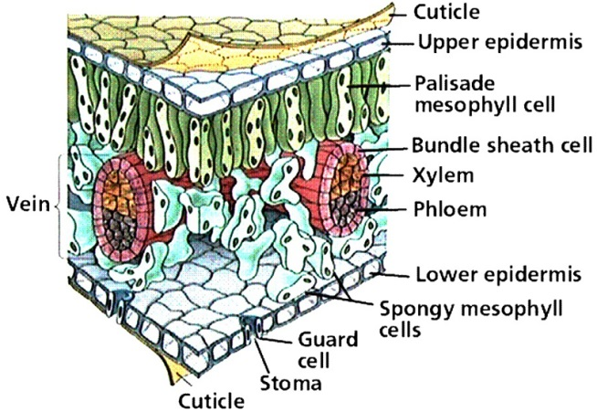
Targeting a Sample Source
Why target traits in specific cells?
  The function
    Tissue- based uses large morphological features (‘leaf’, ‘root’, ‘fruit’)
    Cell-specific samples requires tissue preparation, purification, verification
  Enrichment
    Simpler purification
    Increase yield
    Less contamination
How many samples do you need?
  How much material can you collect from one sample?
  Do you need samples related in a specific way?
  How much natural variation is expected?
Notes:
Chemistry that can change how retrievable material is.
Identification may be by microscopy and LCM, Antibody and FACS or affinity column.
Preparation may involve cryogenic treatment, embedding in inert substrate, inhibiting solutions that preserve molecular and cellular structure.

Slide 8
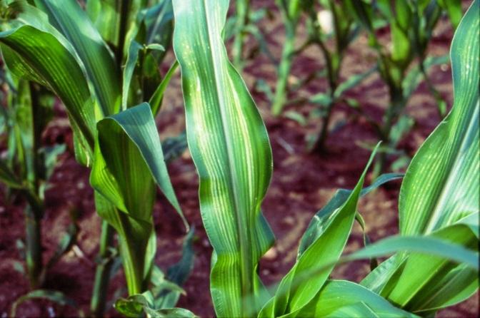

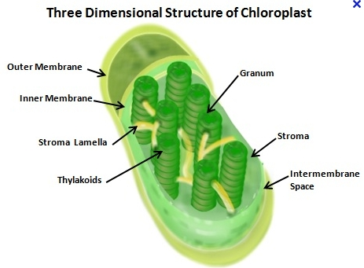
The Chloroplast
The chloroplast is a plant organelle that carries out basic photosynthesis.
  Chlorophyll captures photons and is responsible for the green color
  Electron carriers are set up in the thylakoid membranes
  Also: synthesize fatty acids, amino acids, pigments, vitamins
In land plants (like Chestnut):
  a single circular chromosome (~150,000bp)
  Many copies per chloroplast
  May chloroplasts per cell
  Affects some morphological phenotypes
Notes:
Biotechnology relevance: a good candidate for bioengineering
High level of expression
A cassette model for transformation (multiple genes at once) – and much easier to handle position effects
Maternal inheritance path (containment to seed tissue)
Gene silencing is not seen
Less pleiotropic consequences if one mutates
Can be accomplished without vector or antibiotic sequences

Slide 9
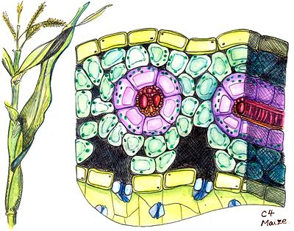
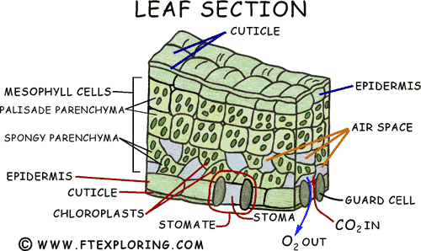
Chloroplast locales
The chloroplast is found in mesophyll cells of leaves, which are in either the palisade parenchyma or the spongy parenchyma.
In C4 plants chloroplasts are also found in bundle-sheath cells.
wikipedia

Slide 10
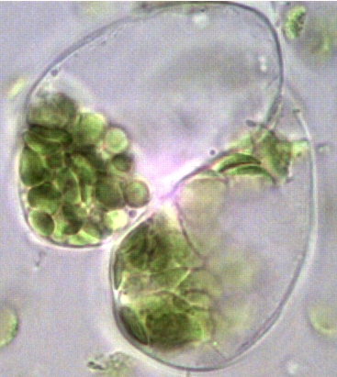
Chloroplast Basics
Size: 5-10um, 20-200 per cell
Location: mesophyll cells/palisade or spongy parenchyma
Type: plastids, in stem, leaves, unripe fruit
  Double membrane boundary of envelope, also the thylakoid membrane
Origin: endosymbionts, retaining some original genome, but most genes moved to nucleus of the ‘host’.
  ~100 genes are still in Cp, proteins are synthesized on 70S ribosomes in the Cp.
  1.7*10⁻¹⁴ gm/molecule, or 1ng =~50,000 molecules.
Image: http://course1.winona.edu/sberg/308s06/Lec-note/Photosynthesis.htm

Slide 11
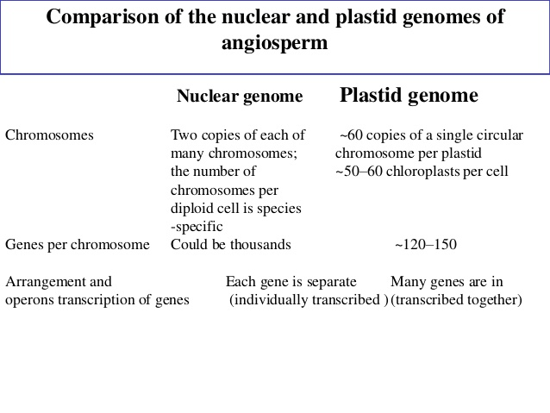

Slide 12
Cp Genome Structure
Cp genome sizes of crop plants range from 134-160.5 kbp.
  Spinacia oleracea (Schmitz-Linneweber et al 2001) had 150,725bp with 108 ORFs.
  Castenea mollissima: 160, 603bp
In higher land plants ~40-50% of the Cp genome is non-coding spacer and regulatory regions.
The ~100 genes include
  A complete set of rRNA and tRNA genes and a eubacterial-type plastid-encoded RNA polymerase (PEP)
    But → the sigma factors, proteins that give gene-specific recognition to the polymerase (‘tune’ it) are nuclear
  Photosynthesis related genes
  Genes for Cp structural components like fatty acid biosynthesis (accD) for making the thylakoid membranes

Slide 13
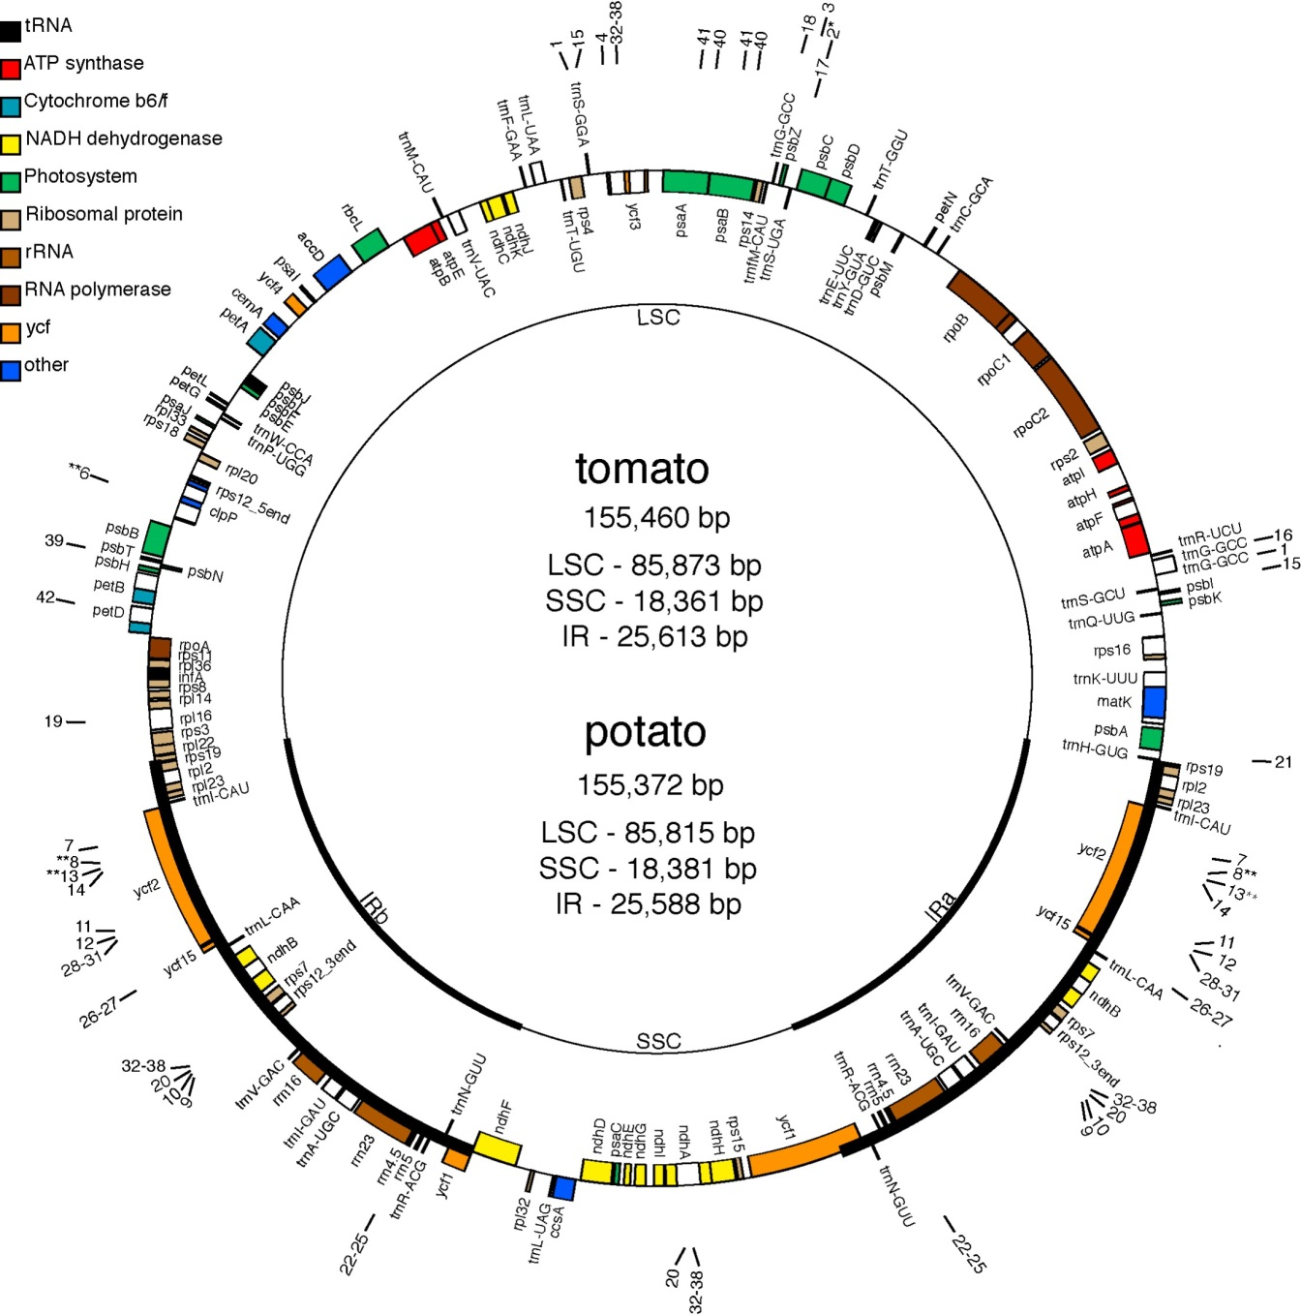
Genes drawn inside the circle are transcribed clockwise, outside are ccw.
An asterisk indicates an intron.
Ψ indicates a pseudogene.
LSC is large single copy region, SSC is small single copy region.
IR means inverted repeat – these regions are 25, 613bp long.
Daniell H, Lee SB, Grevich J, Saski C, Guda C, Tomkins J, Jansen RK.,TAG 2006

Slide 14
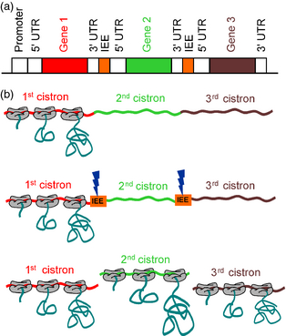
CP Genome Organization
Clusters of genes are arranged in operons
  Polycistronic mRNAs are created (but not always co-translated)
    There are introns (tiny ones)
    There are RNA editing events (C→U conversions)

Slide 15
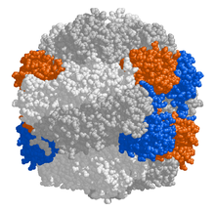
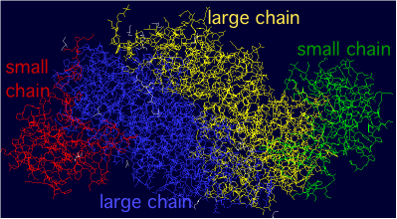
Mixed Gene Location for important CP Proteins
ATPase (uses the proton gradient energy from light harvesting to produce ATP) has 9 polypeptides
  6 are in the cp genome and 3 are nuclear genes
Ribulose Bisphosphate Carboxylase Oxygenase has
  rbcL (Large chain) is from the cp genome, 8 polypeptides in 4 dimers
    rbcL is one of the most conserved CP genes.
  rbcS is encoded in the nucleus (often several types), 8 chains of these also go into the assembly

Slide 16
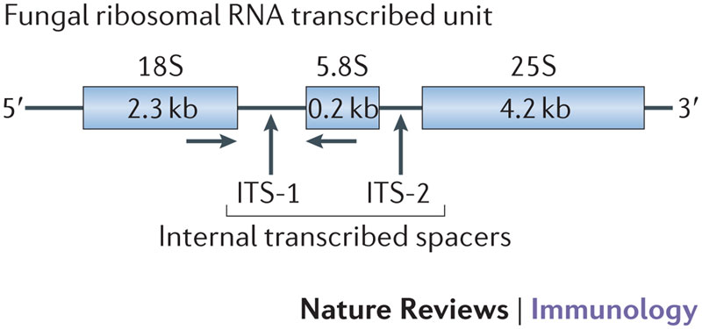
Genes selected as bar codes
DNA barcoding is a taxonomic method that uses a short DNA sequence to identify the sample as belonging to a particular species.
  It is not meant to help you derive a phylogenetic tree- you are using the tree as an existing classification scheme in which to put your unknown.
    If you have a tree then you already have lots of data.
  The sequence has to have enough variation allowed that you get meaningful differences.
  The sequence cannot have so much variation that you cannot find meaningful similarities.
Genes often used in bar coding experiments
  Animals: the cytochrome oxidase I gene (COI) which is on the mitochondrial genome.
  Plants: the ribulose 1.5-bis phosphate decarboxylase/oxidase gene (RubisCO), large subunit (rbcL), which is on the chloroplast genome. This is often combined with the matK gene (also chloroplast). Proposed to add ycf1 (also chloroplast).
    matK is 1500bp long. In the intron of the trnK (tRNA-Lys) gene, coding for maturase-like protein, which splices type-II introns.
    Ycf1 codes for a hypothetical membrane protein of unknown function that does not occur in the Poaceae
  Microbes: the ribosomal RNA genes (16S/23S for prokaryotes and 18S/26S for eukaryotes).
  Fungi: the internal transcribed spacer region (ITS) that lies between multiple 18S genes.
Notes:
Why use mitochondrial and chloroplast sequences?

Slide 17
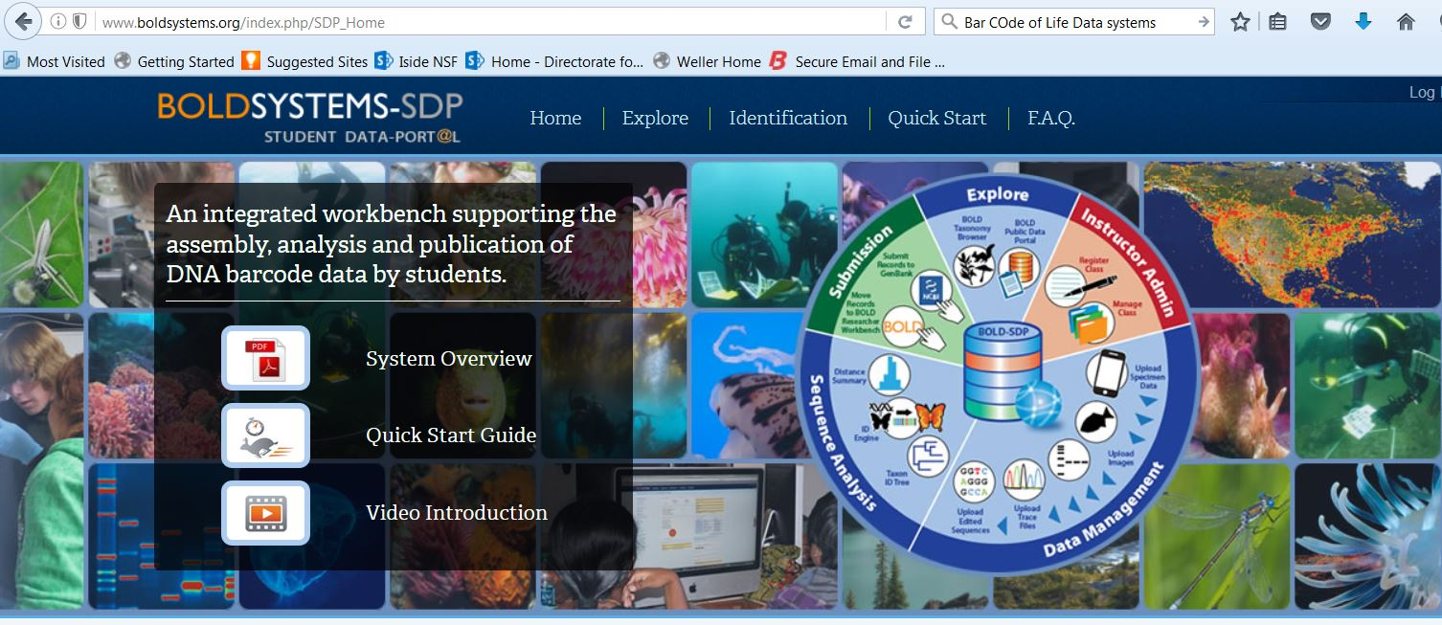
BarCode of Life Data Systems
2 million barcode sequences from >160,000 species.
  See http://www.boldsystems.org/

Slide 18
Non-Barcode Genomic Research Resources
One or more databases contain DNA sequence from your species that includes most of the chromosomal and organellar sequence
  Some organisms, like E coli, have dozens of databases with information.
Genomic databases:
  The data has been assembled so that the order of the sequences is known (location)
  The data has been annotated so that you can find a specific part using a label (genes are tagged for example).
To be a useful too, there should be software that lets you match a sequence of your own to the sequences present in the data set to find the closest match.
  BLAST, BLAT, Smith-Waterman, etc.
Without these resources you may need to carry out a whole-genome sequencing project.

Slide 19
Data repository of sequences for Chestnut?
The Fagaceae Genomics Web site is one option: http://www.fagaceae.org/
  This is not very complete data or tools, although you can search based on sequence
For the Chinese Chestnut: http://www.hardwoodgenomics.org/chinese-chestnut-genome
Whole Genome Sequence (v1.1)
  Over 60 Gb of genomic DNA sequence was generated by next generation sequencing technologies, After contamination removal, the draft genome has been submitted to NCBI
Assembly and Annotation statistics:
  819.7 Mb in 239,153 contigs (N50, 9,340 bp), 103% coverage of estimated genome size (794Mb)
  724.0 Mb in 41,260 scaffolds (N50, 39.6 Kb), 91.2% coverage of estimated genome size (794Mb)
  Organelle DNA: mtDNA
  Gene Prediction in Genome:
    36,478 consensus gene models
    38,146 predicted transcripts and peptide sequences

Slide 20
Assembled genomic Data
At NCBI there is a database of complete genomes of plastics (which includes chloroplasts): http://www.ncbi.nlm.nih.gov/genomes/GenomesGroup.cgi?taxid=2759&opt=plastid
Trees are Viridiplantae – filter for that subset, then look for Castenea – only C. mollissima is given (Chinese) – this is likely to be the closest relative. http://www.ncbi.nlm.nih.gov/Taxonomy/Browser/wwwtax.cgi?lvl=0&id=60419
The table gives you some highlights: there is one genome record, 1 assembly, 130 gene records
  Assembly: http://www.ncbi.nlm.nih.gov/assembly/GCA_000763605.1/
  Organelle assembly: http://www.ncbi.nlm.nih.gov/genome?LinkName=assembly_genome&from_uid=215711
  Annotation Report: http://www.ncbi.nlm.nih.gov/genome/organelles/10727?
  Complete genome sequence NC_014674.1 http://www.ncbi.nlm.nih.gov/nuccore/NC_014674.1
  There is also a set of links to other possibly repositories and tools.

Slide 21
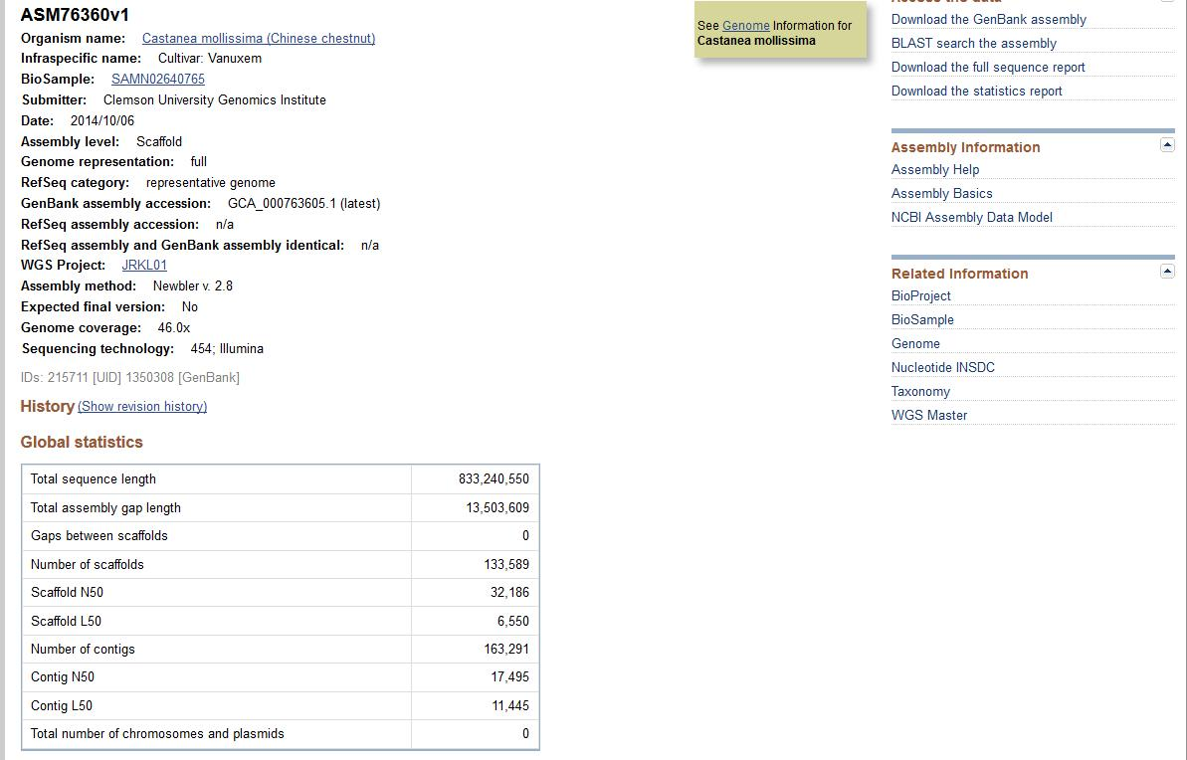

Slide 22
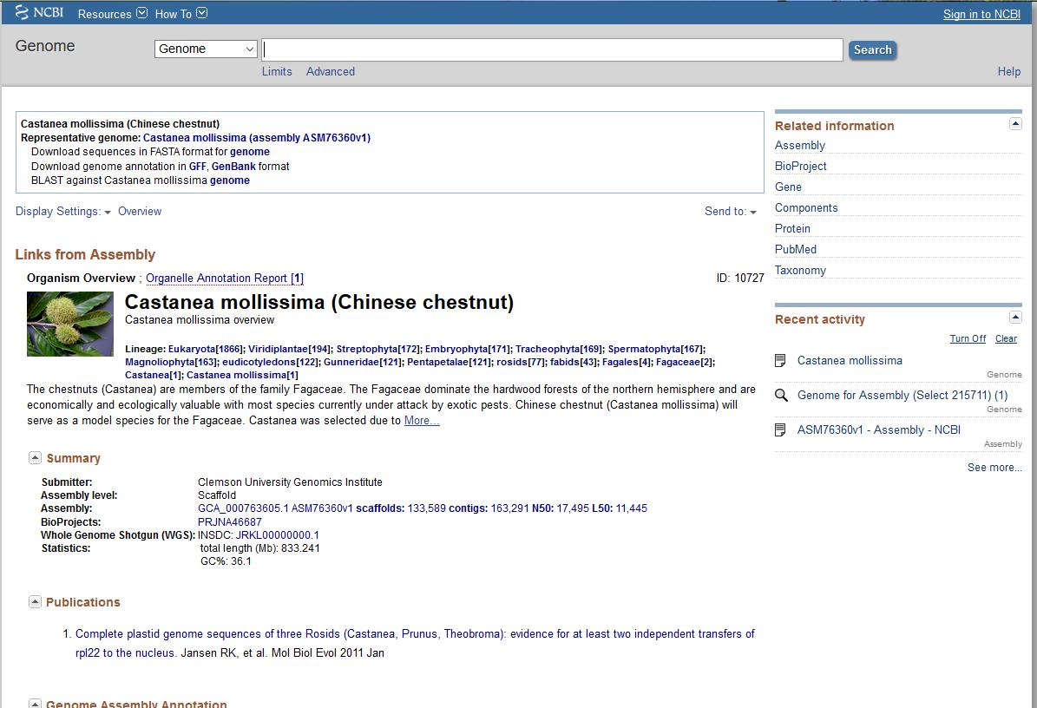

Slide 23
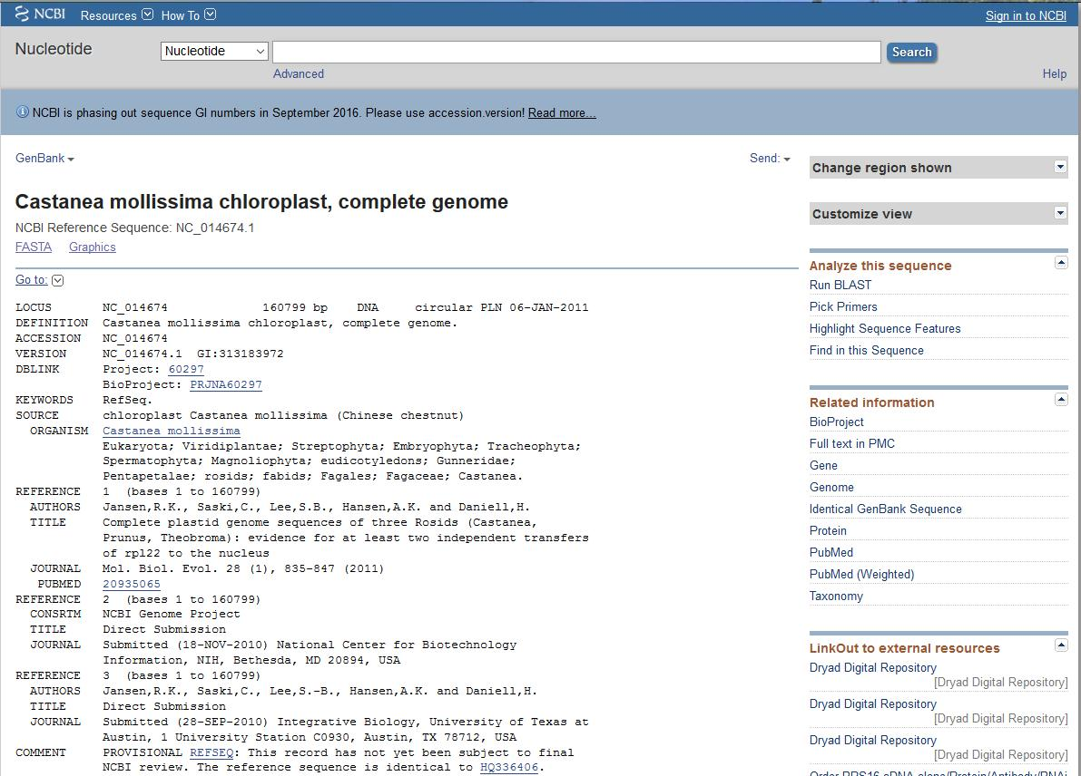

Slide 24
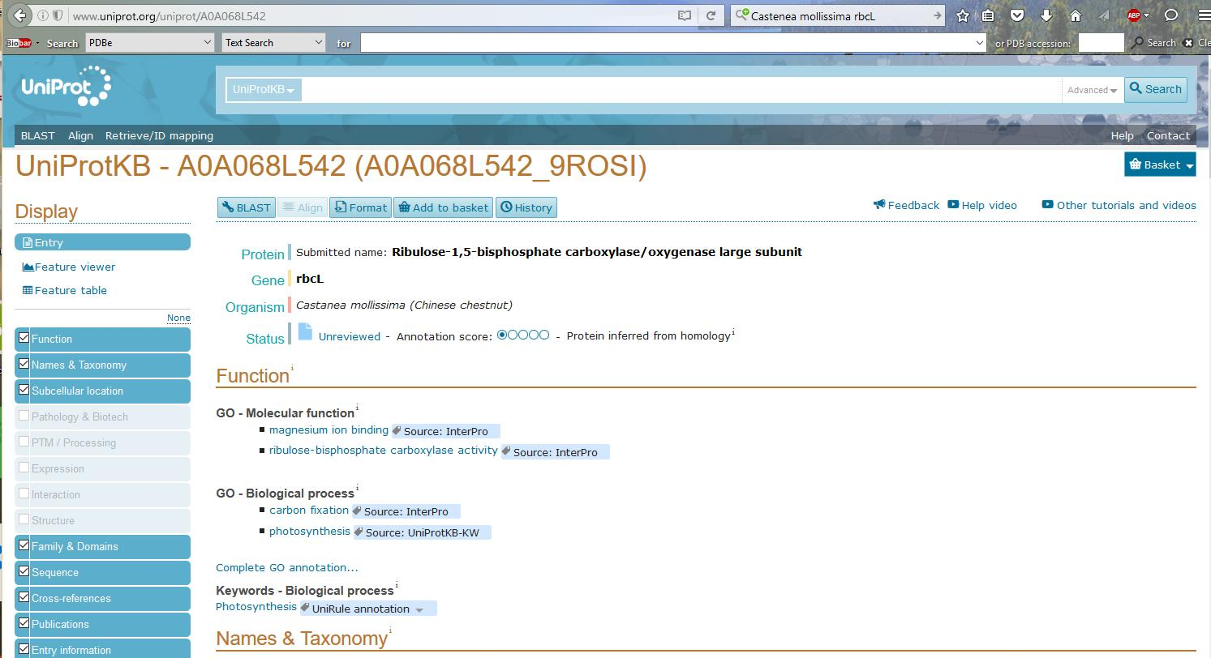

Slide 25
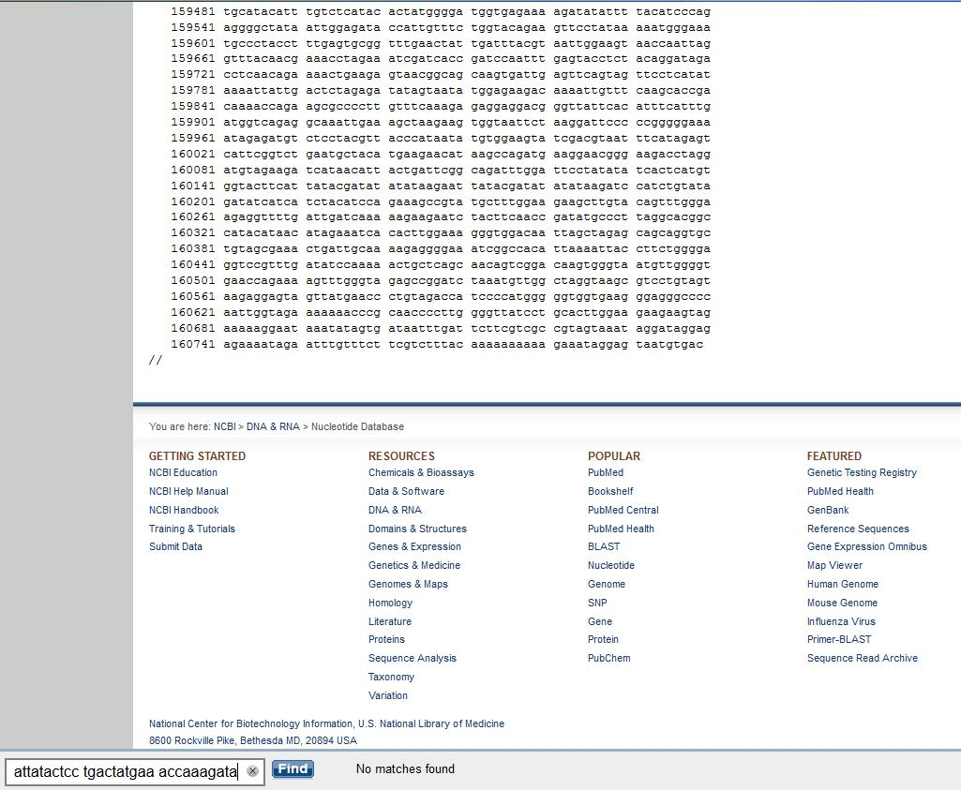

Slide 26
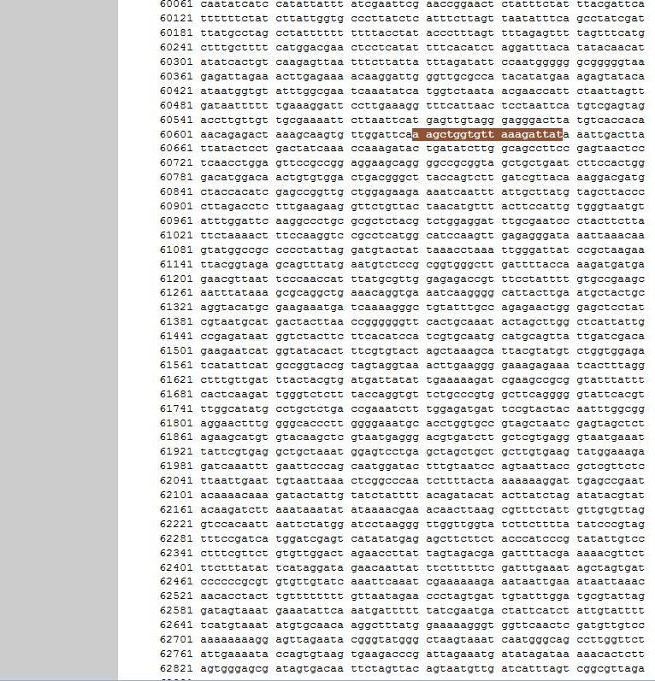

Slide 27
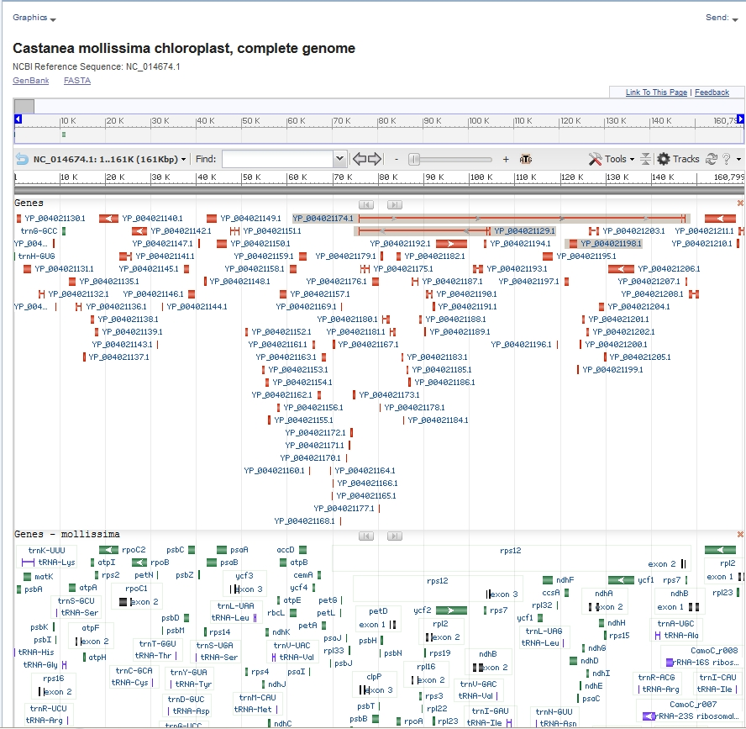

Slide 28
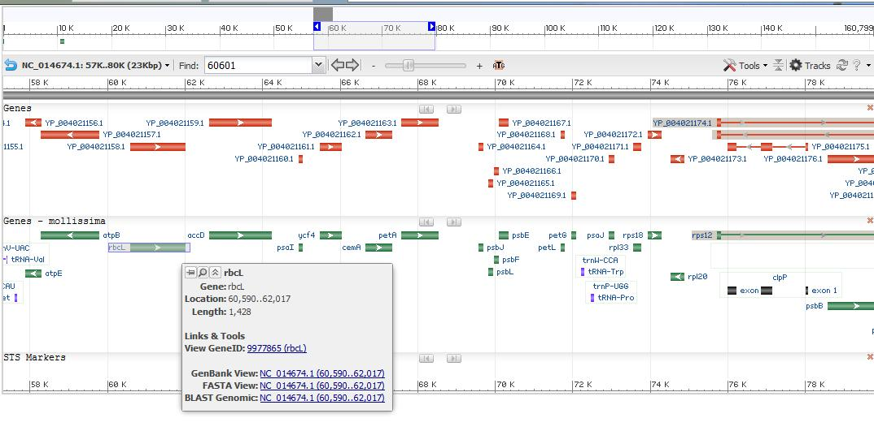
Gene Annotation in Graphics View

Slide 29
See if you can track this down
Find the full sequence of the chloroplast
  Save to a file on your desktop.
Find the following full sequences from the C. mollissima Cp genome, and save them to your desktop
  The Large Ribulose bis 1,5- phosphate oxygenase gene (rbcL) and save it.
  The sequence of the matK gene and save it
  The sequence of the ycf1 gene and save it.
  Note the start and stop positions for each on the full genome, and what strand each is on?
Identify the bar code sequence used in each gene.
Save the sequence that includes 100nt upstream and 100 nt downstream of each gene.
Using just the 100nt upstream of each gene, use the BLAST (blastn) program against the NR database, restricted to plants, and see what sequences are retrieved.

Slide 30
The American Chestnut Complete Chloroplast Genome Project
Confirmed samples: TACF orchard in Hendersonville NC
  Collect in summer science camp
Unknown samples: Crowder’s Mt. State Park
  Collect in summer science camp
Tissue to collect: leaf, stored on dry ice (Summer science camp)
Process for DNA: process X amount from each sample
  Amount determined in the Bioinformatics camp
  Reactions carried out in the summer science camp
Select out the chloroplast DNA:
  PCR amplify 15 long segments (designed in the Bioinformatics camp)
Process to create libraries and sequence at UNCC
  Summer science camp
Carry out sequence quality scores, assemble and compare
  Steps explained in Bioinformatics camp, can be carried out on actual data later in the summer by interested students
Publish the data
  All students names will be included on the publication

Slide 31
Saturday Lab: Find the Chinese Chestnut Chloroplast sequence
Divide the Chloroplast genome into 12 x15,000bp chunks.
Save each chunk as a file (name them so you can keep them ordered)
Note: They should overlap by ~200 bp
Identify one protein-coding gene in each chunk, make a note about its name, start position, end position and strand in a file and save that.
We will use this data in the DNA subway Blue Line, and in the PCR design lab.

